Slide 1


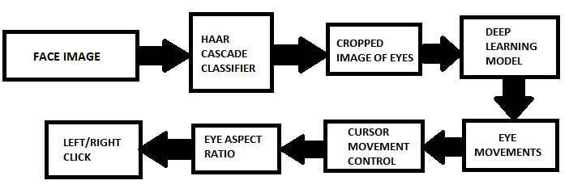
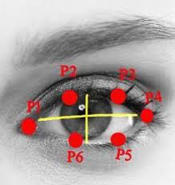
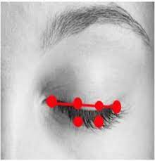
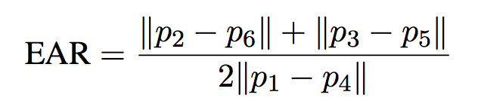
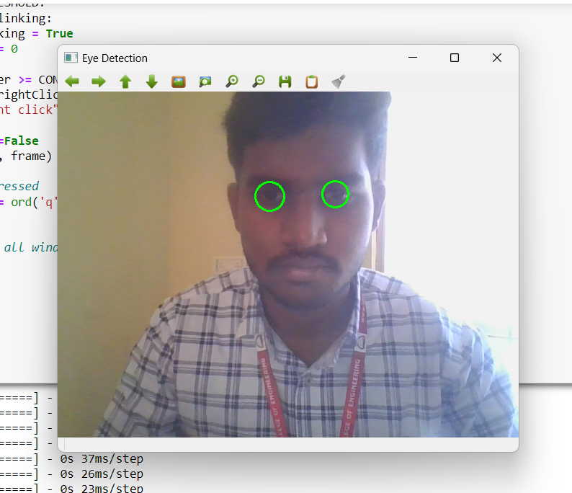
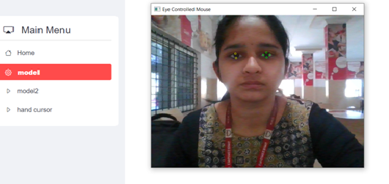
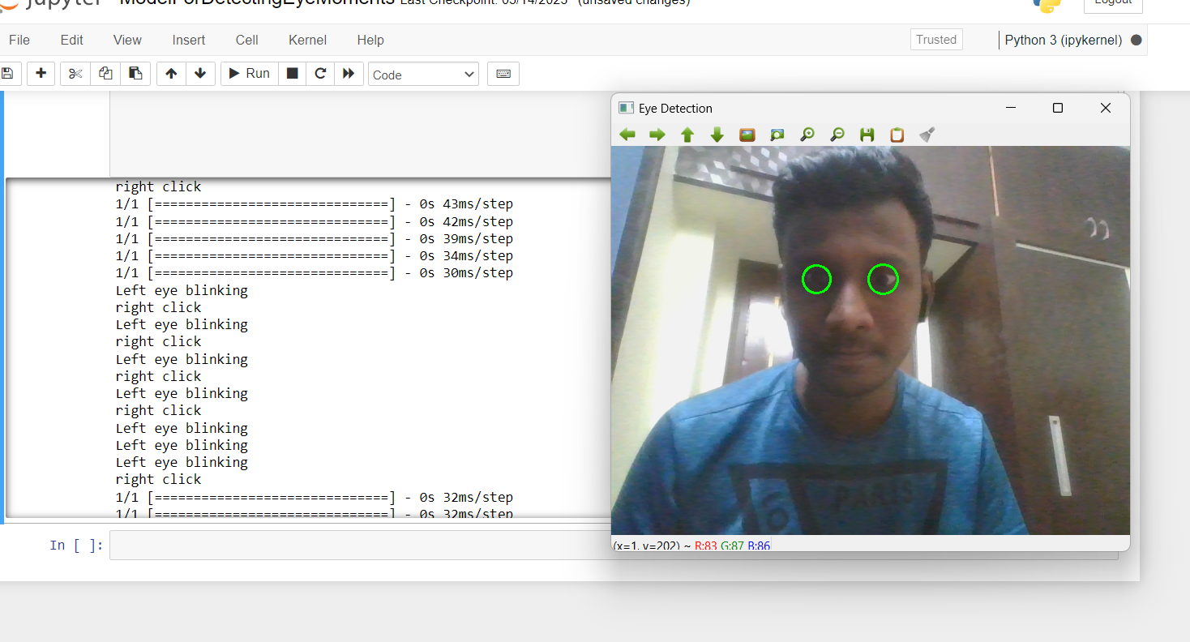
VARDHAMAN COLLEGE OF ENGINEERING
(AUTONOMOUS)
Affiliated to JNTUH, Approved by AICTE, Accredited by NAAC with A++ Grade, ISO 9001:2015 Certified
Kacharam, Shamshabad, Hyderabad-501218, Telangana, India
DEPARTMENT OF COMPUTER SCIENCE AND ENGINEERING
EYE BALL CURSOR MOMENT USING DEEP LEARNING
T.Sharmili ,V.Srinivas, V.Umesh. Batch-19CSPW-B8
INTRODUCTION
FLOW CHARTS AND FORMULAE
The rapid advancement of computer technologies has significantly highlighted the importance of Human-Computer Interaction (HCI). For disabled persons, Eye Ball Movement Control is often employed as an accessible means of using computers.
A Human-Computer Interaction (HCI) system is being implemented, allowing users to control computers with their eyes
OBJECTIVES
Open eye
Closed eye
To detect eyes using haar cascade classifier.
By using Deep learning to detect the cursor position on screen.
Calculating eye aspect ratio to perform click operations.
Flowchart : Process model.
METHODOLOGY
RESULTS AND DISCUSSION
Data set & Haar cascade classifier
We have used the support of Haar cascade classifier which is used for object detection. In this algorithm the model trains with many positive and negative values based on the shadowing and edge feature, line feature and four rectangle feature. There is an open source xml file which can be downloaded from the github link of OpenCV or creating the dataset we have looped with the frames of our face using OpenCV and generated an event listener which will capture the image when an click operation is done. While clicking it is necessary to look at the cursor because it will be the picture storing with a file name of “X_pixel Y_pixel_buttonPressed”.
Model Training
We have used a sequential model which consists of 3 convolution layers and a max pooling layer. We have run around 200 epochs and lose value was satisfying. After getting good accuracy we have deployed the model. The sequence of the layers are 3 convolution layers, succeeded with one max pooling layer for getting a sensible feature map. It is flattened into normal numeric layers with 2 dense layers. You can see the flow of layers for the model training used in the process in the below diagram(fig 5) of model summary.
FIGURE 1: EYE TRACKING
FIGURE 2: STREAMLIT INTERFACE
Eye Tracking
Eye tracking and eye movement research use the eye aspect ratio (EAR) measurement to gauge how much of the eye is open or closed. It is determined by the location of the eye's landmarks, which are normally the top and bottom, as well as the inner and outer corners. A threshold value of 0.2 is established in our software to employ EAR in eye tracking and cursor movement to identify whether the user's eyes are open or closed. The system assumes that the eyes are closed if the EAR is below the threshold value and stops or inhibits cursor movement.
FIGURE 3 : CURSOR OPEARTIONS
CONCLUSIONS
REFERENCES/PUBLICATIONS
. We are looking forward to generalize the cursor control to the remote controlling of televisions or any other software. For this we need an hardware device which will do the whole thing at once and perform the task at ease. A specs or As or aim is to control computer with eyes. We are looking to implement few other operations which can be done by mouse. Other than click operations there are scrolling operation, selection of text and typing. For typing we are trying to invoke a virtual keyboard and the letters that are clicked will be displayed on the notepad or other blank screen. something with a camera inbuilt and the whole process running can make the daily life easier and interesting.
1. Khare, Vandana, S. Gopala Krishna, and Sai Kalyan Sanisetty. "Cursor Control Using Eye Ball Movement." In 2019 Fifth International Conference on Science Technology Engineering and Mathematics (ICONSTEM), vol. 1, pp. 232-235. IEEE, 2019.
2 Sharafi, Zohreh, Timothy Shaffer, and Bonita Sharif. "Eye-Tracking Metrics in Software Engineering." In 2015 AsiaPacific Software Engineering Conference (APSEC), pp. 96-103. IEEE, 2015.
3 Chandra, S., Sharma, G., Malhotra, S., Jha, D. and Mittal, A.P., 2015, December. Eye tracking based human computer interaction: Applications and their uses. In 2015 International Conference on Man and Machine Interfacing (MAMI) (pp. 1-5). IEEE..

